Slide 1

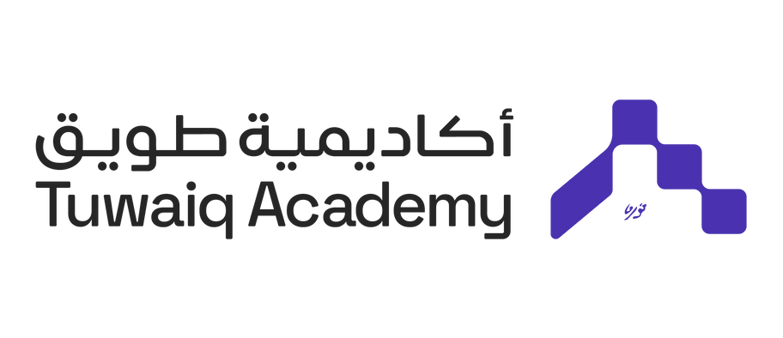


Zeham Management Technologies BootCamp
car
detection
GROUP 4
Alyaa Bajaber
Khuzama Alsenan
Anas Alwohaib
Saleh Alanazi
01

Slide 2


Zeham Management Technologies BootCamp
Introduction
Our project leverages YOLO
(You Only Look Once) technology for real-time vehicle detection at traffic signals, Highway and accurately counting the number of cars that waiting at each intersection or in entrance to the city,
We gathered data from various online sources to ensure a comprehensive and diverse dataset.
02

Slide 3

Zeham Management Technologies BootCamp
Challenge / Solution
Challenge
Solution
Traditional traffic management systems operate on fixed schedules and do not adapt to real-time traffic conditions. This can result in wasted time at signals, increased driver frustration, and increased emissions from parked vehicles.
Our solution is to implement an intelligent traffic management system using YOLO (You Only Look Once) technology for real-time vehicle counting.
03

Slide 4
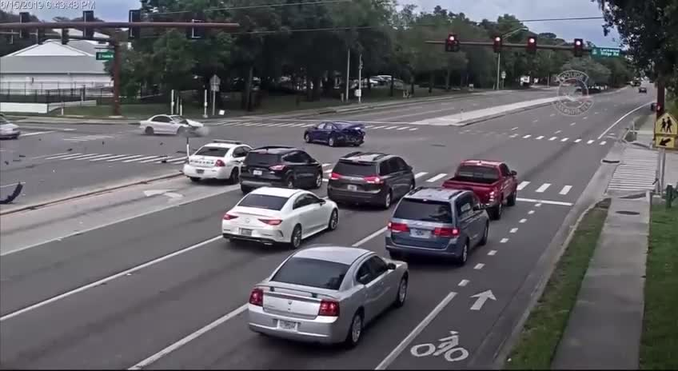
Zeham Management Technologies BootCamp
before detection
04

Slide 5
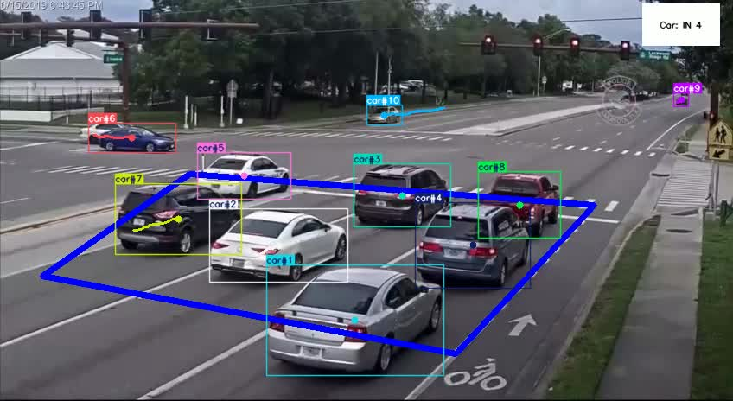
Zeham Management Technologies BootCamp
Results
Traffic light Counting
05

Slide 6
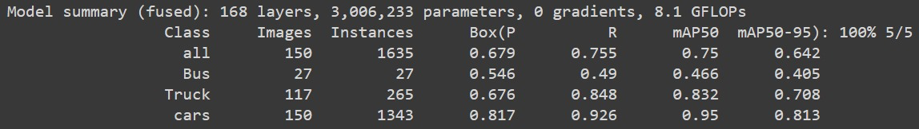
Zeham Management Technologies BootCamp
Results
Accuracy
06

Slide 7
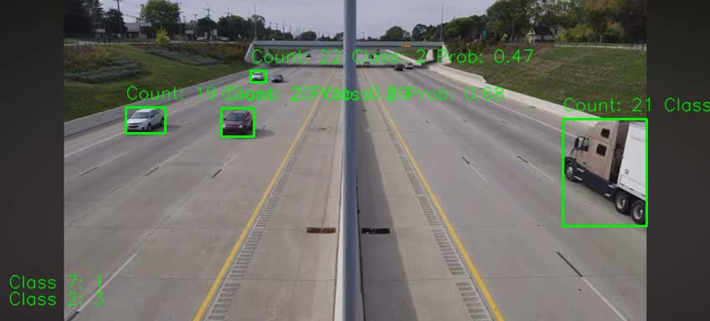
Zeham Management Technologies BootCamp
Results
Vehicle Count Highway
07

Slide 8
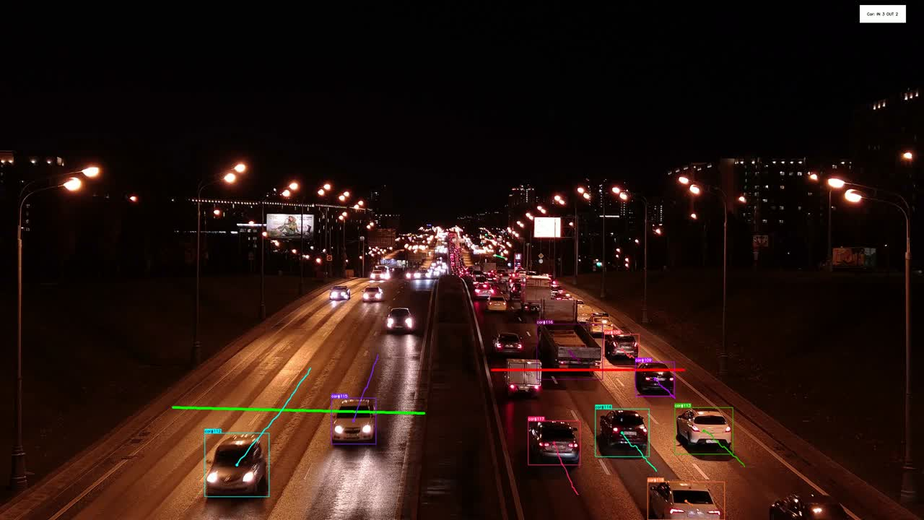
Zeham Management Technologies BootCamp
Results
Vehicle night count
08

Slide 9

Zeham Management Technologies BootCamp
Conclusion
Our project has the potential to significantly improve traffic efficiency and reduce congestion, leading to:
Shorter Travel Times: Drivers will experience reduced wait times at intersections, saving time and fuel.
Reduced Emissions: Optimized traffic flow will minimize idling time and fuel consumption, contributing to a cleaner environment.
Improved Safety: Smoother traffic flow can lead to fewer accidents and a safer driving experience.
09

Slide 10
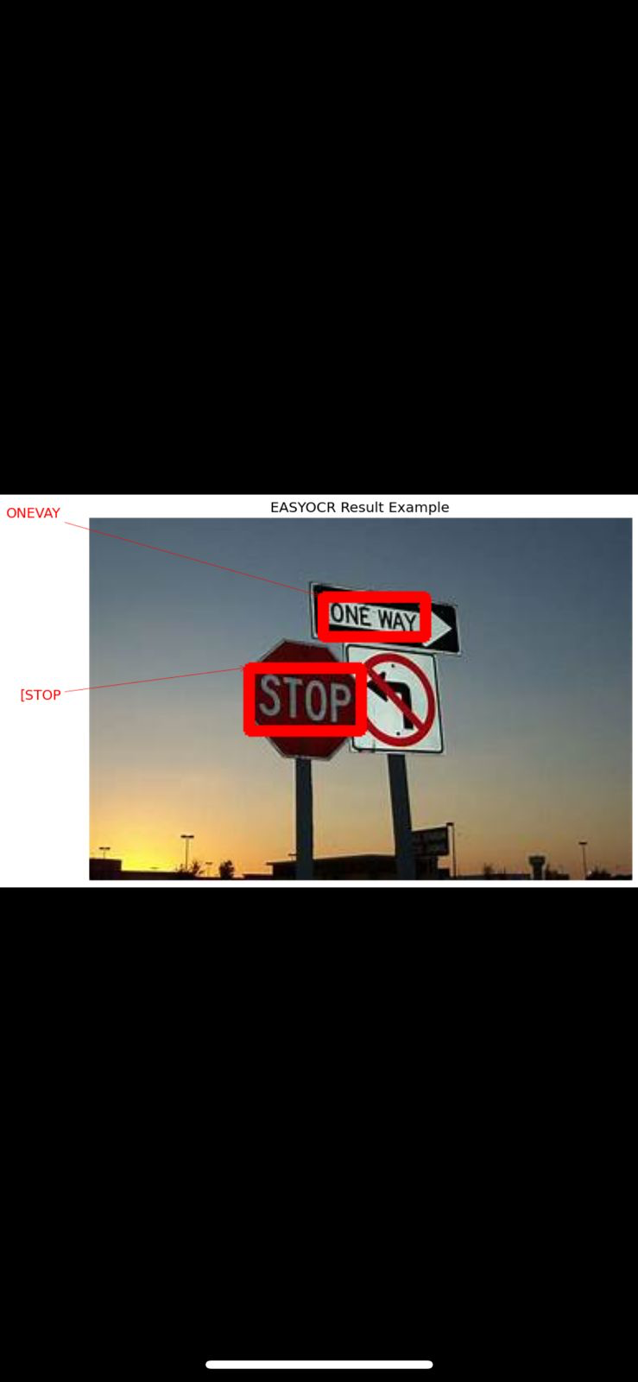
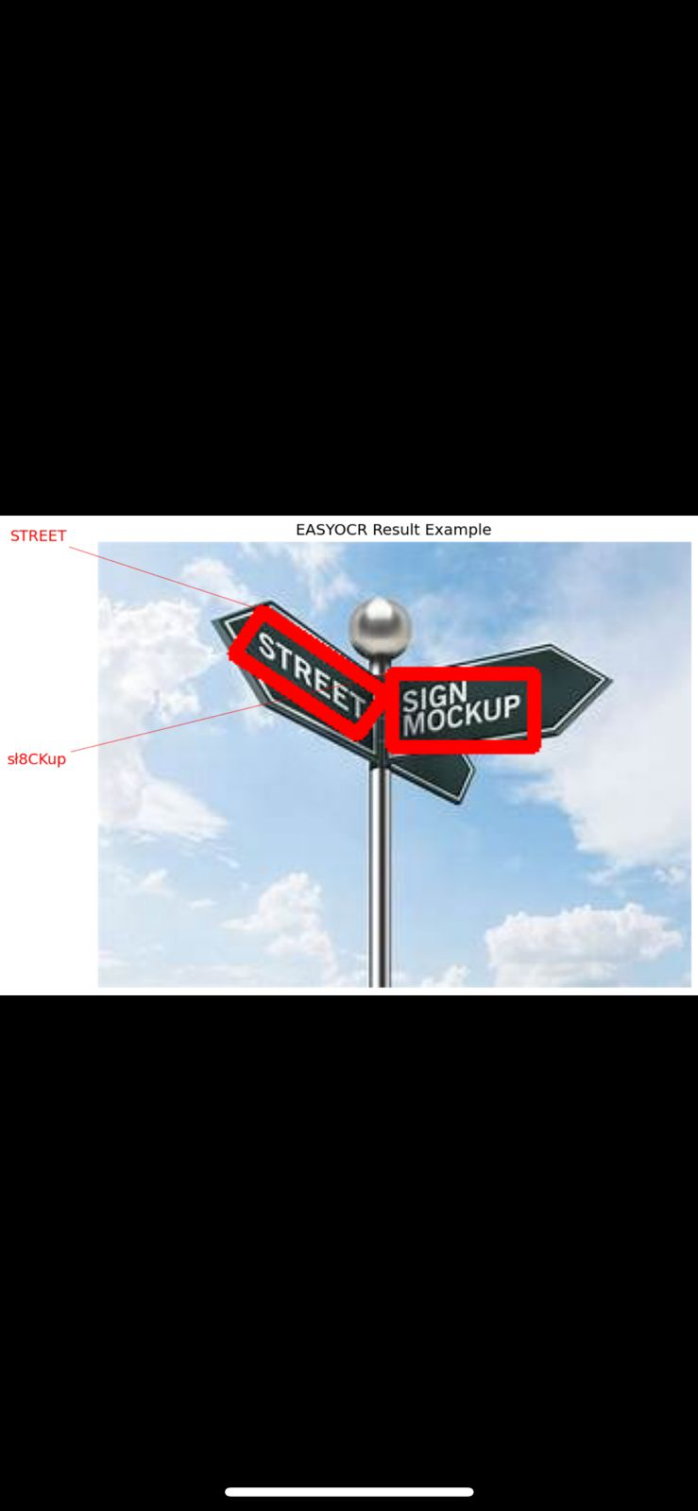
Zeham Management Technologies BootCamp
Bonus Tasks
OCR
Using easy OCR, Reader function, to be read readtext from the images
10

Slide 11
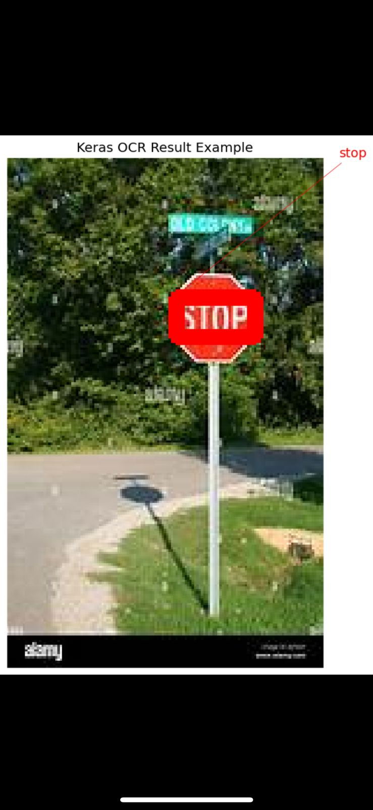
Zeham Management Technologies BootCamp
Bonus Tasks
OCR
11

Slide 12
Zeham Management Technologies BootCamp
Conclusion
Our OCR project for traffic sign recognition has proven to be a valuable advancement in enhancing road safety and efficiency for smart vehicles. The system achieved high accuracy in recognizing traffic signs, which enables intelligent vehicles to make informed decisions quickly.
12

Slide 13

Zeham Management Technologies BootCamp
Thank You
For Watching
13

